Slide 1
Ludwig Van Beethoven
1770-1827
Nancy Schechter - violin
Raisa Isaacs -- piano
Broward College
April 5, 2018

Slide 2
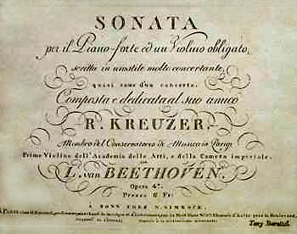
Violin Sonata No. 9 (Beethoven)
The Violin Sonata No. 9 of Ludwig van Beethoven, commonly known as the Kreutzer Sonata, was published as Beethoven's Opus 47 in 1800. It is known for its demanding violin and piano parts, unusual length (a typical performance about 35 minutes), and emotional scope — while the first movement is predominantly furious, the second is meditative and the third joyous and exuberant.

Slide 3
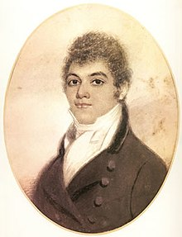
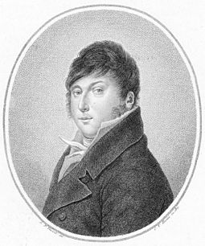
The sonata was originally dedicated to the violinist
George Bridgetower (1778–1860)
as "Sonata mulattica composta per il mulatto Brischdauer gran pazzo e compositore mulattico" (Mulatto Sonata composed for the mulatto Brischdauer, great madman mulatto composer). Shortly after completion the work was premiered by Bridgetower and Beethoven on 24 May 1803 at the Augarten Theatre.
After the premiere performance Beethoven and Bridgetower fell out and Beethoven removed the dedication of the piece, dedicating it instead to Rodolphe Kreutzer, who was considered the finest violinist of the day. He never played it, saying that it had already been performed once and was too difficult

Slide 4
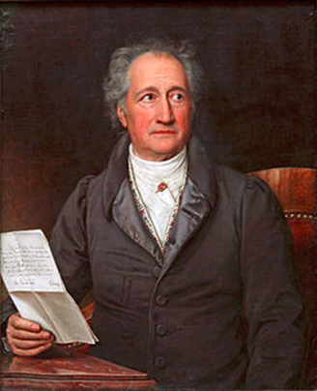
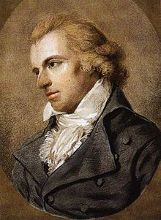
Beethoven and Sturm und Drang
Sturm und Drang "Storm and Urge", though conventionally translated as "Storm and Stress") is a proto-Romantic movement in German literature and music taking place from the late 1760s to the early 1780s, in which individual subjectivity and, in particular, extremes of emotion were given free expression in reaction to the perceived constraints of rationalism imposed by the Enlightenment and associated aesthetic movements.
Weimar Classicism (German: Weimarer Klassik) is a German literary and cultural movement, whose practitioners established a new humanism, from the synthesis of ideas from Romanticism, Classicism, and the Age of Enlightenment.
The Weimarer Klassik movement, lasted thirty-three years, from 1772 until 1805, and involved intellectuals such as Johann Wolfgang Goethe, Johann Gottfried Herder, Friedrich Schiller, and Christoph Martin Wieland; and then was concentrated upon Goethe and Schiller during the period 1788–1805.
Notes:
Johann Wolfgang von Goethe was born in August 1749, in the Free Imperial City of Frankfurt, Holy Roman Empire. He wrote his first important play, Goetz von Berlichingen in 1773, in Shakespearean style, a defining characteristic of the Sturm und Drang movement (Wilson and Goldfarb 287). Shakespeare was considered a genius among German playwrights, and was idolized for his “shattering of the dramatic unities of time, place and action; and his sharply individualized, emotionally complex characters” (Waterhouse v). Goethe was well known for his staging as well as his long dramatic poem Faust (Goethe's Faust) (Wilson and Goldfarb 287). Goethe was the director of theatre at the WeimarTheatre where he eventually ran the entire company. He went to Italy for two years to collect himself and while there discovered the beauty of the Greek and Roman ruins. After this trip he returned with interest in classical ideas and writing, and a new form of writing emerged called Weimar Classicism.
Schiller[edit]
Friedrich Schiller was born in Marbach on November 10, 1759. He studied medicine at Karlsschule Stuttgart, a prestigious military academy founded by the Duke of Württemberg. He developed a strong relationship with Goethe, one of the most influential writers of the time (Wilson and Goldfarb 287). They were particularly interested in questions concerning aesthetics. This relationship leads to an epoch known as Weimar Classicism, a style that integrates classical, romantic and enlightenment ideals (Leidner xiv). Following Schiller’s plays, Die Räuber (The Robbers) and Kabale und Liebe (Intrigue and Love), he went on to became a major poet as well as to write famous essays and Weimar Classical drama (Leidner xiv). The Robbers tells the story of two brothers, the younger of which is infuriated by how society favors the first-born child and he acts on his feelings without any regard to societal rules or social standing. In act five, his views on God “represent the most blasphemous attack on religion in German literature up to that time… [and] is a masterful work of social dynamics that takes deep German patterns of sensibility into account” (Leidner xiv).
Johann Christoph Friedrich von Schiller (German: [ˈjoːhan ˈkʁɪstɔf ˈfʁiːdʁɪç fɔn ˈʃɪlɐ]; 10 November 1759 – 9 May 1805) was a German poet, philosopher, historian, and playwright. During the last seventeen years of his life (1788–1805), Schiller struck up a productive, if complicated, friendship with the already famous and influential Johann Wolfgang von Goethe. They frequently discussed issues concerning aesthetics, and Schiller encouraged Goethe to finish works he left as sketches. This relationship and these discussions led to a period now referred to as Weimar Classicism. They also worked together onXenien, a collection of short satirical poems in which both Schiller and Goethe challenge opponents to their philosophical vision.

Slide 5

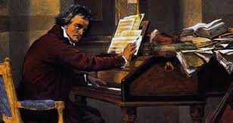
The piece is in three movements, and takes approximately 43 minutes to perform:
Adagio sostenuto – Presto (A major – A minor, sonata form, about 15 minutes in length)
The sonata opens with a slow 18-bar introduction, of which only the first four bars of the solo violin are in the A-Major-key. The piano enters, and the harmony begins to turn darker towards the minor key, until the main body of the movement — an angry A-minor Presto— begins. Here, the piano part matches the violin's in terms of difficulty. Near the end, Beethoven brings back part of the opening Adagio, before closing the movement in an anguished coda.
Presto (A major, sonata form, about 10 minutes)
The calm is broken by a crashing A major chord in the piano, ushering in the virtuosic and exuberant third movement, a 6/8 tarantella in sonata form. After moving through a series of slightly contrasting episodes, the theme returns for the last time, and the work ends jubilantly in a rush of A major.

Slide 6
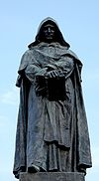
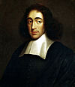
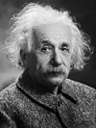
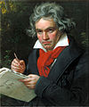
Beethoven and Pantheism
Pantheism is the belief that the universe (or nature as the totality of everything) is identical with divinity, or that everything composes an all-encompassing, immanent God. Pantheists thus do not believe in a distinct personal or anthropomorphic god.
Theism - "strictly and properly called Theists, who affirm, that a perfectly conscious understanding being, or mind, existing of itself from eternity, was the cause of all other things“ (E. Kant)
Notes:
Giordano Bruno (Italian: [dʒorˈdano ˈbruno]; Latin: Iordanus Brunus Nolanus; 1548 – 17 February 1600 CE), born Filippo Bruno, was an Italian Dominican friar, philosopher, mathematician, poet, and astrologer.^{[3]} He is celebrated for his cosmological theories, which went even further than the then-novel Copernican model. He proposed that the stars were just distant suns surrounded by their own exoplanets and raised the possibility that these planets could even foster life of their own (a philosophical position known as cosmic pluralism). He also insisted that the universe is in fact infinite and could have no celestial body at its "center".
Beginning in 1593, Bruno was tried for heresy by the Roman Inquisition on charges including denial of several core Catholic doctrines (including the Trinity, the divinity of Christ, the virginity of Mary, and Transubstantiation). Bruno's pantheism was also a matter of grave concern.^{[4]} The Inquisition found him guilty, and in 1600 he was burned at the stake in Rome's Campo de' Fiori. After his death he gained considerable fame, being particularly celebrated by 19th- and early 20th-century commentators who regarded him as a martyr for science,[
Baruch Spinoza (/bəˈruːk spɪˈnoʊzə/;^{[3]} Dutch: [baːˈrux spɪˈnoːzaː]; born Benedito de Espinosa, Portuguese pronunciation: [benɨˈðitu ðɨ iʃpɨˈnozɐ]; 24 November 1632 – 21 February 1677, later Benedict de Spinoza) was a Dutch philosopher of Sephardi Portugueseorigin.^{[2]} The breadth and importance of Spinoza's work was not fully realized until many years after his death. By laying the groundwork for the 18th-century Enlightenment^{[4]} and modern biblical criticism,^{[5]} including modern conceptions of the self and the universe,^{[6]} he came to be considered one of the great rationalists of 17th-century philosophy
Johann Wolfgang Goethe (/ˈɡətə/;^{[1]} German: [ˈjoːhan ˈvɔlfɡaŋ ˈɡøːtə] ( listen); 28 August 1749 – 22 March 1832) was a German writer and statesman. His body of work includes epic and lyric poetry written in a variety of metres and styles; prose and versedramas; memoirs; an autobiography; literary and aesthetic criticism; treatises on botany, anatomy, and colour; and four novels. In addition, numerous literary and scientific fragments, more than 10,000 letters, and nearly 3,000 drawings by him are extant.

Slide 7
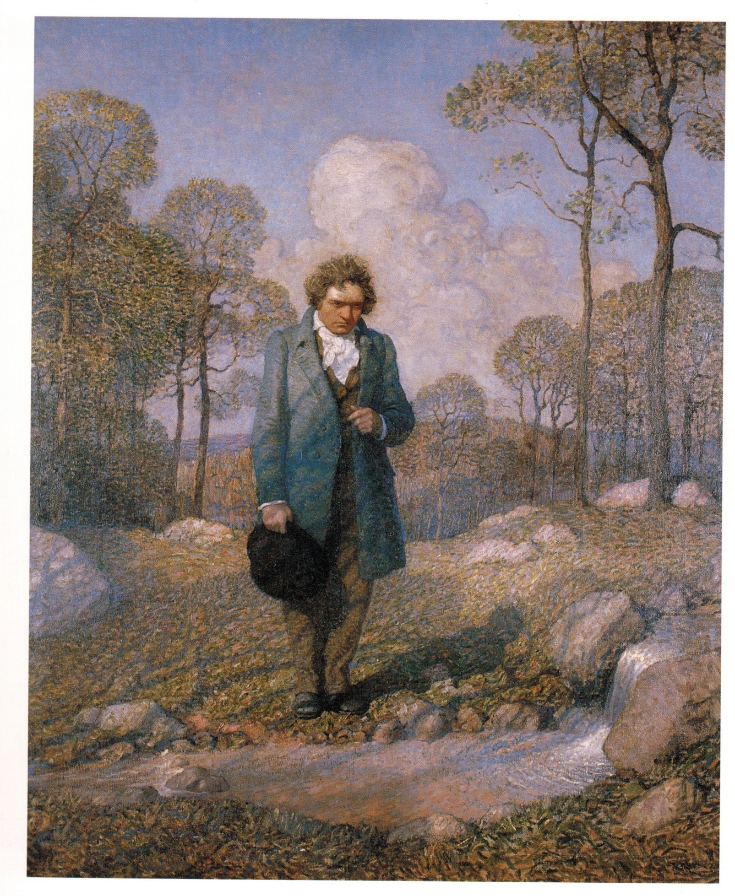
mvt.II Andante con variazioni
Andante con variazioni (F major, variation form, with the third variation in F minor, about 18 minutes)
There could hardly be a greater contrast with the second movement, a placid tune in F major followed by five distinctive variations. The first variation transliterates the theme into a lively triple meter while embellishing it with trills, while in the second the violin steals the melody and enlivens it even further. The third variation, in F minor, returns to a darker and more meditative state. The fourth recalls the first and second variations with its light, ornamental, and airy feel. The fifth and final variation, the longest, caps the movement with a slower and more dramatic feel, nevertheless returning to the carefree F major. This is not the only work by Beethoven having all of the following features: a) 3 movements b) 1st and 3rd are in tonic (tonic is in minor key) c) 2nd movement is in submediant of tonic d) 2nd movement is theme and variation(another being is 23rd piano sonata 'Appasionata'). Source: https://en.wikipedia.org/wiki/Piano_Sonata_No._23_(Beethoven)

Slide 8
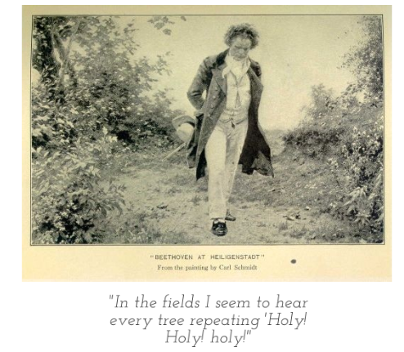
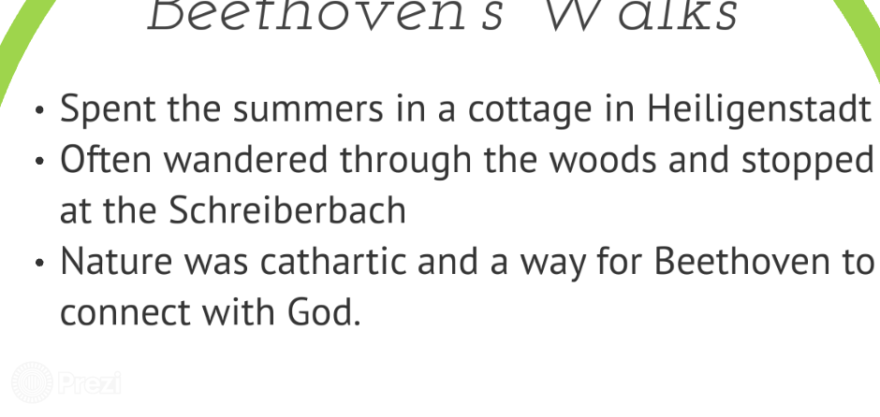
Beethoven was a lover of nature who spent a great deal of his time on walks in the country. He frequently left Vienna to work in rural locations. ... It was composed simultaneously with Beethoven's more famous—and more fiery—Fifth Symphony.

Slide 9
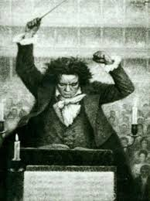
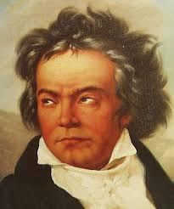
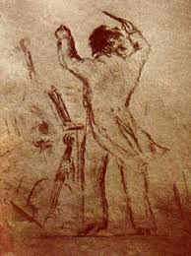
Mvt III, Presto
Presto (A major, sonata form, about 10 minutes)
The calm is broken by a crashing A major chord in the piano, ushering in the virtuosic and exuberant third movement, a 6/8 tarantella in sonata form. After moving through a series of slightly contrasting episodes, the theme returns for the last time, and the work ends jubilantly in a rush of A major.

